Slide 1

Data Analytics for Secure Decision-Making in Network Management
Your Name: Mohammad Thaher
Your ID: 21110274
Date:12/08/2023

Slide 2

Introduction
I will utilize data analytics to analyze network traffic simulations and identify patterns of different types of network attacks, using data analytics tools and techniques, I aim to comprehend the data and uncover meaningful patterns, furthermore, I will effectively try communicate the findings to enhance network security and performance.
Data analytics can help in detecting security breaches and improving network performance, it aids in identifying potential bottlenecks and vulnerabilities, additionally, data analytics can be instrumental in predicting future attacks.

Slide 3

Data Analytic Activities, Techniques, and Tools

Slide 4

Data Analytic Activities
Data Collection: The first stage is to gather data that is pertinent to the study's particular objectives. Sources for this information include network traffic records, security systems, and vulnerability scanners. The information must cover a wide variety of network activity and attack kinds in order to be as complete as feasible.
Data exploration is the process of looking for patterns in the data after it has been gathered. Different visualization methods, including heatmaps, line graphs, and pie charts, can be used to do this. Gaining a deeper grasp of the data and finding any potential patterns or anomalies are the objectives of this stage.
Finding Attack Patterns: Finding attack patterns is the last phase. Techniques like clustering and classification can be used for this. While classification algorithms may be used to categorize attack occurrences into distinct classes, clustering methods can be used to group similar attack instances together. This step's objectives are to recognize various assault types and create defenses against them.

Slide 5

The techniques used
A statistical technique that aids in summarizing and describing data is descriptive analysis. It is used to learn more about the distribution, central tendency, and variability of the data.
info(): The dataset's essential characteristics, such as the number of rows and columns, the data types of the columns, the amount of missing values, and the memory use, are all provided by this function.
describe(): For each of the dataset's numerical columns, summary statistics are computed using this procedure. These statistics, such as the mean, median, standard deviation, lowest and maximum values, may be utilized to better understand the distribution of the data.
hist(): This function generates a histogram, a visual depiction of the distribution of data. It displays the frequency of data falling into certain categories.
Box plots, sometimes called box-and-whisker plots, are produced using the boxplot() function. It gives a visual snapshot of the data's distribution and aids in the detection of outliers.
Data analysis with the purpose of learning and gaining new insights is known as exploratory data analysis (EDA). In contrast to descriptive analysis, it takes a more exploratory approach to data analysis and is frequently used to find patterns and correlations in the data.
Table that displays the correlation coefficients between each pair of variables in a dataset is known as a correlation matrix. The linear link between two variables is measured by the correlation coefficient.
Contingency table: This is a table that displays how frequently two category variables appear together. It may be used to comprehend how categorical variables are related and associated.

Slide 6

Tools used
Python stands as a formidable and user-friendly programming language, renowned for its accessibility. It proves particularly advantageous for beginners entering the realm of data analysis.
Specifically tailored to data analysis, Python boasts an array of modules. Noteworthy among these are NumPy, Pandas, Matplotlib, and Seaborn, to name a few.
Python's versatility shines in its capacity to adeptly handle a diverse spectrum of data processing tasks. Thus, it serves as an ideal solution for data analysts contending with various data formats.
Python enjoys an expansive community of enthusiastic users and developers, fostered by its open-source nature. This bountiful support network equips learners with ample resources to master Python and embark on their data analysis journey
The ascendancy of Python in the realm of data analytics can be attributed to its malleability and the rich assortment of libraries available. Its learnability and user-friendly nature make it a preferred choice for novices and seasoned analysts alike. Catering to both data analysts and scientists, Python's toolkit, encompassing NumPy, Pandas, Matplotlib, and Seaborn, empowers comprehensive data manipulation, analysis, and visualization.

Slide 7

Data Analytics in Industry

Slide 8

Data Analytic Methods
Descriptive analytics enables the monitoring of cyberattack frequency, prevalent attack types, and the targeted industries. Predictive analytics, on the other hand, allows the identification of cyberattack trends, which in turn can be employed to predict imminent attacks.
For instance, predictive analytics can identify individuals with a high susceptibility to falling for phishing scams or websites prone to hacking. Stepping further, prescriptive analytics can offer optimal strategies to prevent or mitigate cyberattacks.
An example of prescriptive analytics includes recommending specific security measures for fortifying a company's network or advising appropriate actions following a cyberattack. This comprehensive analytical approach aids in both proactive protection and reactive response to cyber threats.

Slide 9

Exploratory Data Analysis Techniques (EDA)

Slide 10
Explanation and importance of EDA data analysis
EDA is a process of inspecting, visualizing, and summarizing a dataset to understand its main characteristics, patterns, and relationships.
EDA is important in data analysis because it helps analysts to:
Understand the data
Identify potential issues
Formulate hypotheses
Select features
Build models
Communicate findings
Ensure data integrity
Save time and resources

Slide 11
EDA Techniques used
The describe() function is used to calculate the summary statistics for the data. This includes the mean, median, mode, minimum, maximum, range, standard deviation, and variance.
The boxplot() function is used to create a box plot of the Rest_Energy variable by Type. This helps to visualize the distribution of the data and to identify any potential outliers.
The barplot() function is used to create a bar plot of the Packet_Size variable by behaviour. This helps to visualize the distribution of the data and to identify any potential patterns.
The scatterplot() function is used to create a scatter plot of the Time vs Rest_Energy variable by behaviour. This helps to visualize the relationship between the two variables and to identify any potential correlations.

Slide 12
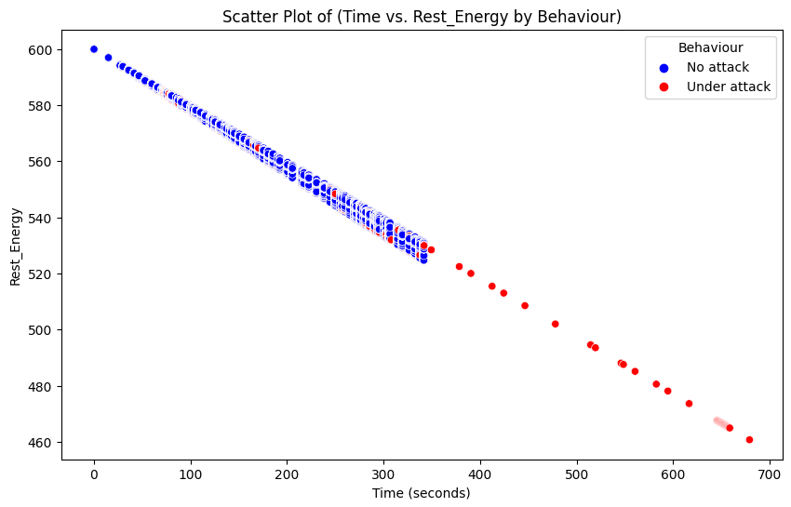
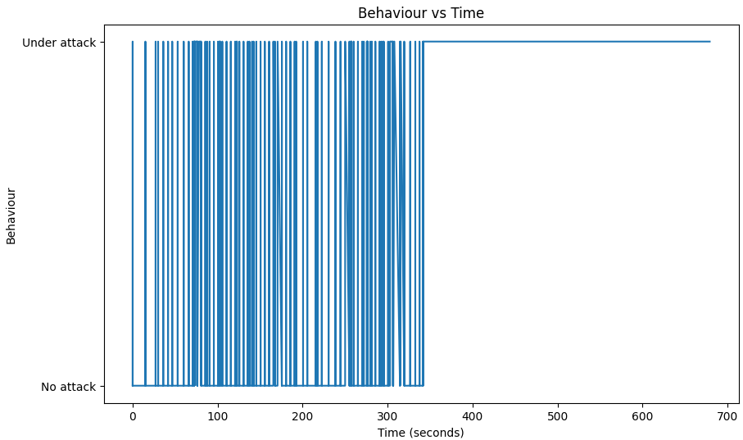
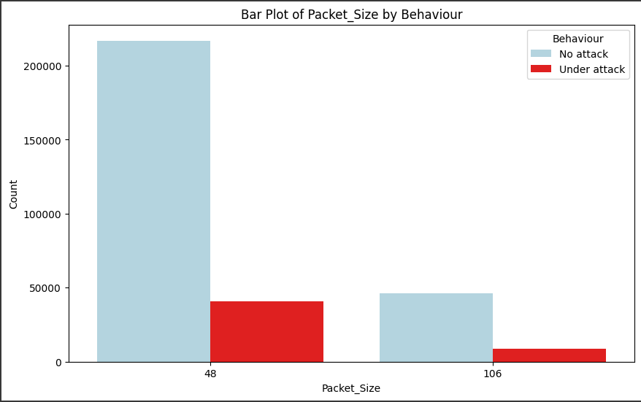
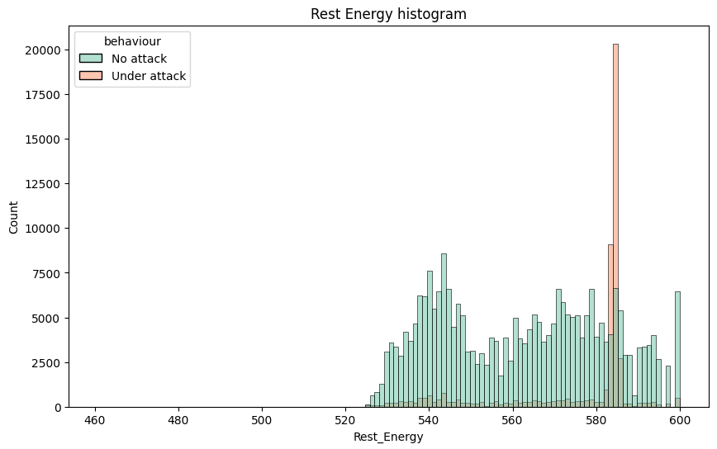
EDA Examples
The charts show that the network is more active when under attack. This is evident in the higher number of packets being sent and the higher Rest Energy levels. The network also sends larger packets when under attack, which can put a strain on the network infrastructure. The Rest Energy of the network increases over time when under attack, which suggests that the network is becoming more stressed.
These findings can help businesses improve their network security measures to mitigate the effects of attacks. Businesses can do this by implementing firewalls, intrusion detection systems, and other security measures to block malicious traffic. Businesses can also monitor their network traffic for signs of attacks and take action to mitigate the effects of an attack.

Slide 13

Descriptive Analytic Techniques

Slide 14
Descriptive Analytics: Techniques and Decision-Making Importance
Descriptive analytics involves the use of various techniques to summarize, interpret, and present data in a meaningful and informative way. These techniques help in understanding the basic characteristics and patterns present in the dataset without attempting to draw conclusions or make predictions.
Descriptive analytic techniques are important in decision-making because they provide a clear and concise overview of data. This allows decision-makers to identify trends, patterns, and outliers. This information can then be used to make informed decisions about the future.

Slide 15
Descriptive Analytic Techniques used
Central tendency: This is the tendency of data to cluster around a central value. The code uses the describe() function to calculate the mean, median, and mode for each numerical column in the dataset.
Dispersion: This is the spread of data around the central value. The code uses the describe() function to calculate the minimum, maximum, range, standard deviation, and variance for each numerical column in the dataset.
Correlation: This is the degree of association between two variables. The code uses the corr() function to calculate the correlation coefficient for each pair of numerical columns in the dataset.
Visualization: The code uses the matplotlib library to create visualizations of the data, such as histograms, box plots, and scatter plots. These visualizations can help to identify patterns and trends in the data.

Slide 16
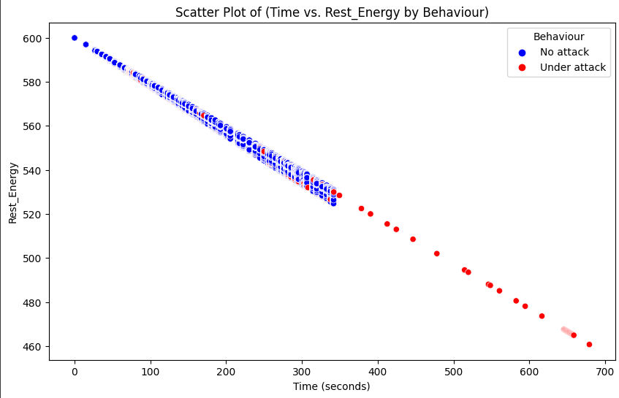
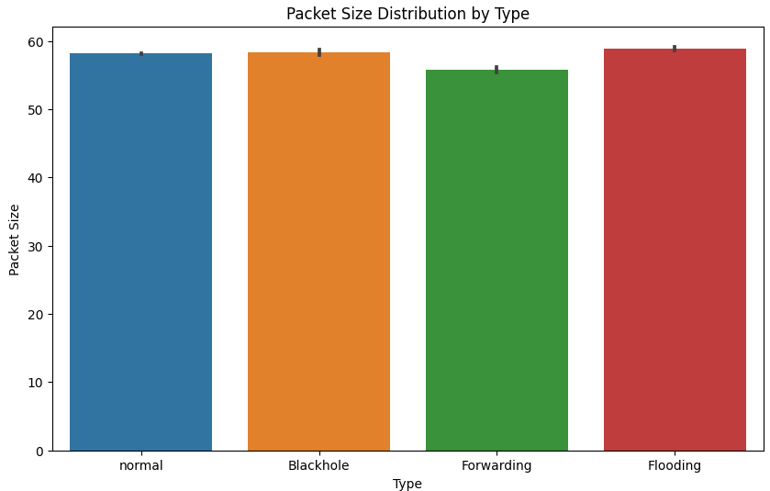
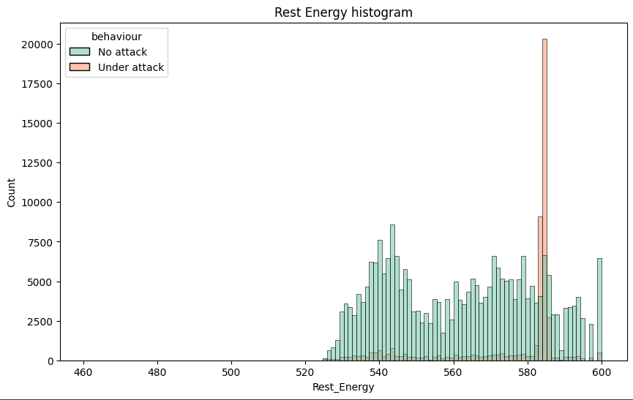
Feature Analysis
The first visualization shows the distribution of Rest Energy for both No attack and Under attack data points. The distribution for Under attack is skewed to the right, with most values clustered around 0. This suggests that the majority of the data points are under attack. The distribution for No attack is more normally distributed, with a wider range of values. This suggests that the network is more active when under attack.
The second visualization shows the distribution of Packet Size for both No attack and Under attack data points. The distribution for Under attack has a higher mean than the distribution for No attack. This suggests that the network is sending larger packets when under attack.
The third visualization shows the correlation between Time and Rest Energy for both No attack and Under attack data points. There is a positive correlation between Time and Rest Energy for the Underattack data points. This suggests that the Rest Energy of the network increases over time when under attack.

Slide 17
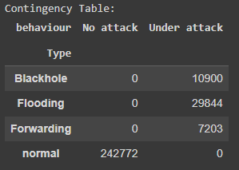
Association Analysis
A contingency table is a table that shows the frequency of two categorical variables. It can be used to quantify the relationship between the two variables.
In the image, the contingency table shows that there is a strong relationship between the behaviour and Type variables. The Blackhole type is more likely to occur when the behaviour is Under attack, while the Flooding type is more likely to occur when the behaviour is No attack. The network administrator can use these insights to improve network security measures and mitigate the effects of attacks.

Slide 18

Role of Analysis in Decision Making
Identify Potential Security Threats: Through the examination of network traffic data, network administrators have the ability to detect potential security vulnerabilities, such as irregular patterns or questionable activities. This data can subsequently guide actions to mitigate these risks, such as enforcing security protocols or blocking suspicious traffic.
Enhance Network Performance: By uncovering points of congestion and weaknesses within the network, network administrators can enhance overall performance. For instance, they can pinpoint overloaded network links or susceptible devices vulnerable to attacks. This knowledge can be employed to fine-tune network settings or introduce security countermeasures.
Anticipate Future Capacity Requirements: Through an analysis of historical network traffic data, network administrators can anticipate future demands for capacity. This information ensures that the network possesses the requisite capability to accommodate anticipated increases in data flow.
For instance, a telecommunications enterprise could utilize network traffic data to strategize for upcoming capacity necessities. If there's a noticeable upward trend in network traffic, this serves as an indicator for potential network infrastructure upgrades. Subsequently, the telecommunications company can leverage this insight to blueprint future capacity enhancements.

Slide 19

Importance of Data Analytical Techniques to Decision-Making
Uncovering Potential Security Vulnerabilities: Employing techniques like clustering and classification, network administrators can identify potential security threats by grouping similar attack occurrences and categorizing them by type. This insight forms the basis for taking corrective actions, such as deploying security protocols or intercepting harmful traffic.
Enhancing Network Performance: By utilizing data exploration methods, network administrators can locate bottlenecks and vulnerabilities within the network infrastructure. This data serves as a foundation for refining network setup or implementing security measures to enhance performance.
Anticipating Future Capacity Requirements: Relying on historical network traffic data, network administrators can forecast future capacity needs. This information guarantees that the network is equipped to accommodate projected traffic increases.
Harnessing Artificial Intelligence: Artificial intelligence techniques come into play for automating the process of identifying and responding to cyberattacks. This automation liberates human resources to focus on alternative tasks, like devising novel security strategies.

Slide 20
Conclusion
The probability of a network being targeted increases when there's a "Blackhole" behavior. This particular attack type disrupts network communication by injecting harmful traffic into the target network.
Moreover, during an attack, the network tends to transmit larger packets. This tactic is employed by attackers to overwhelm the network with an excessive flow of data.
Network administrators can leverage these observations to enhance network security and counteract attack impacts. For instance, they could enforce a firewall to obstruct malicious traffic from infiltrating the network. Continuous monitoring of network traffic for attack indicators would enable swift intervention to mitigate attack consequences.
Expanding the dataset on network traffic would provide a deeper grasp of attack patterns, facilitating the development of more intricate security protocols.
Developing a real-time machine learning model for attack detection could enable automated blocking of malicious traffic at the network's entry points.
Collaborating with other entities to exchange information about attacks would contribute to bolstering overall internet security.

Slide 21
References
Lawton, G. (2022) What is prescriptive analytics? definition from searchcio, CIO. Available at: https://www.techtarget.com/searchcio/definition/Prescriptive-analytics (Accessed: 08 August 2023).
Numpy tutorial (no date) Tutorials. Available at: https://www.w3schools.com/python/numpy/default.asp (Accessed: 08 August 2023).
Pandas tutorial (no date) Tutorials. Available at: https://www.w3schools.com/python/pandas/default.asp (Accessed: 08 August 2023).
Pandian, S. (2022) Effective data visualization techniques in data science using Python, Analytics Vidhya. Available at: https://www.analyticsvidhya.com/blog/2021/08/effective-data-visualization-techniques-in-data-science-using-python/ (Accessed: 08 August 2023).
Reynolds, K. (2019) A guide to understanding the different types of data available to marketers, ClickZ. Available at: https://www.clickz.com/a-guide-to-understanding-the-different-types-of-data-available-to-marketers/ (Accessed: 08 August 2023).
Visualizing regression models¶ (no date) Visualizing regression models - seaborn 0.11.2 documentation. Available at: https://seaborn.pydata.org/archive/0.11/tutorial/regression.html (Accessed: 08 August 2023).
What is exploratory data analysis? (no date) IBM. Available at: https://www.ibm.com/topics/exploratory-data-analysis (Accessed: 08 August 2023).

